Slide 1
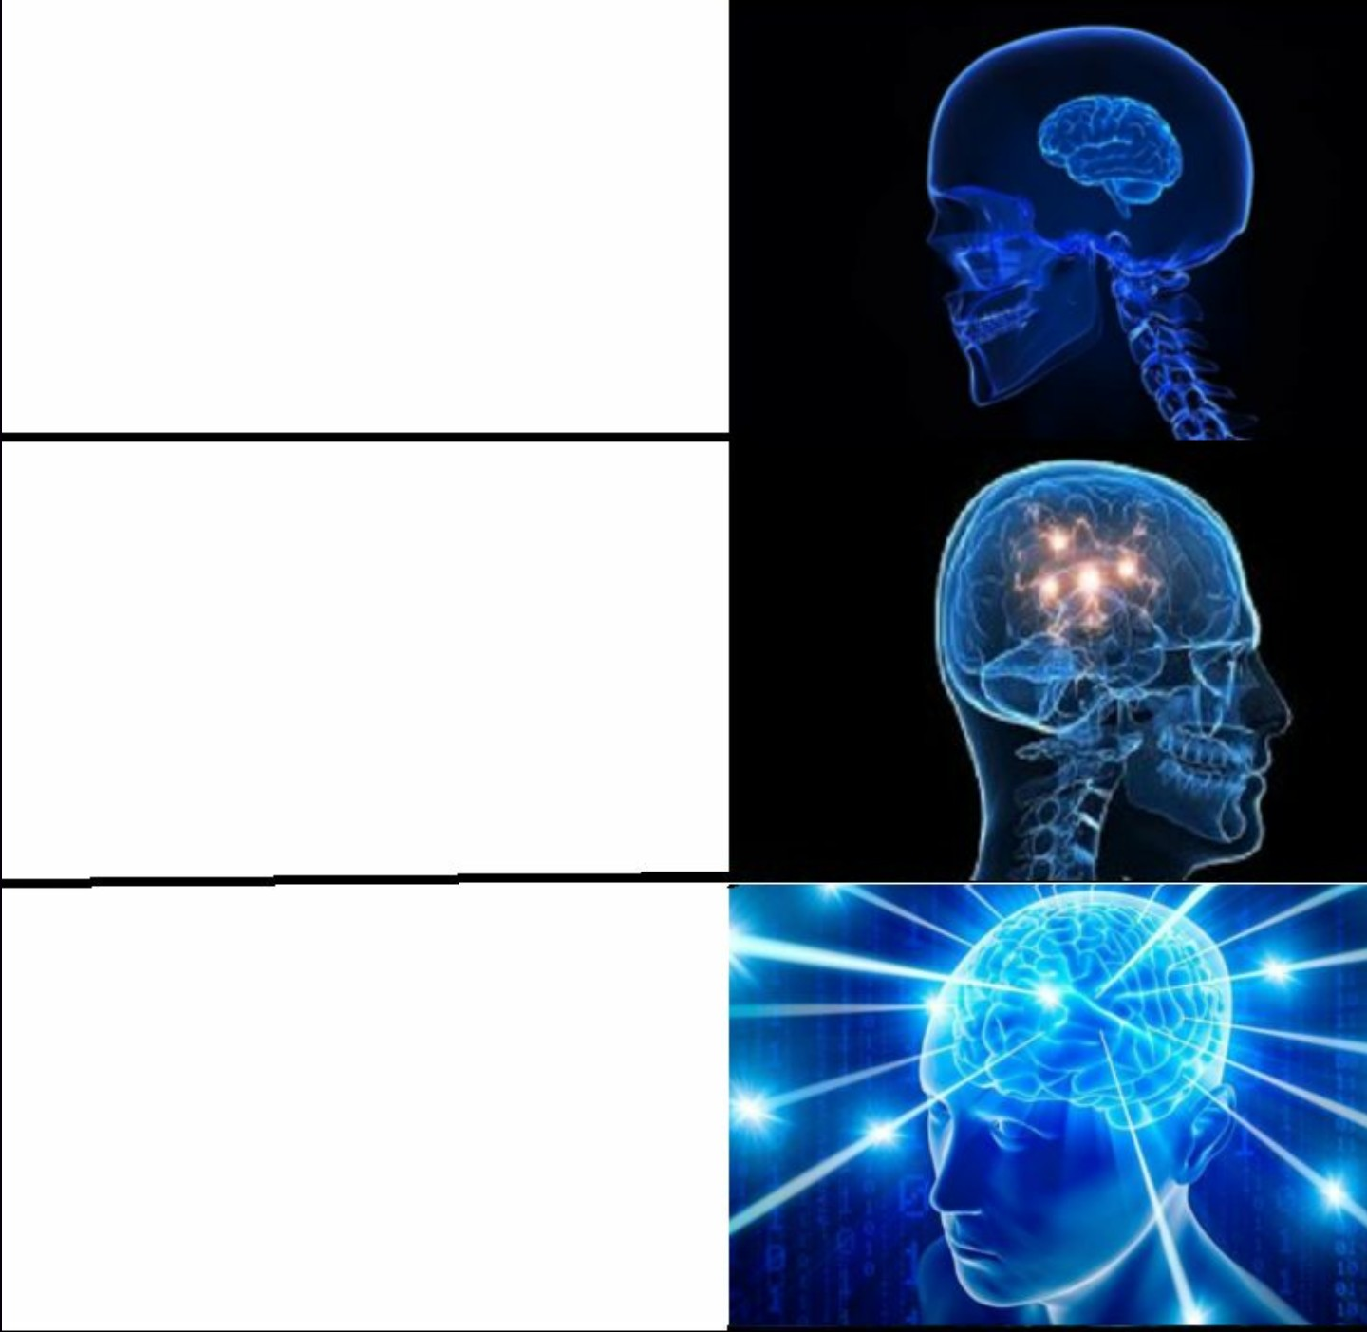

Take a class over the
summer to keep up
Take 18 credits,
get burned out
TAKE A FUCKING NAP

